Slide 1
LENDING CLUB CASE STUDY
BY – Sangeet and Niharika

Slide 2
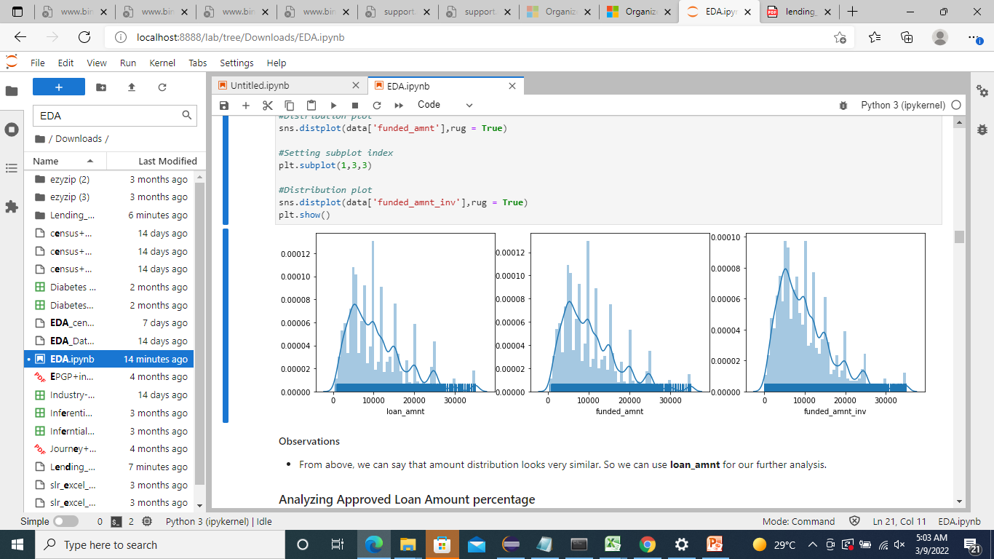
Data Analysis - Univariate
Observation - From above fig, we can say that amount distribution looks very similar. So we can use loan_amnt for our further analysis

Slide 3
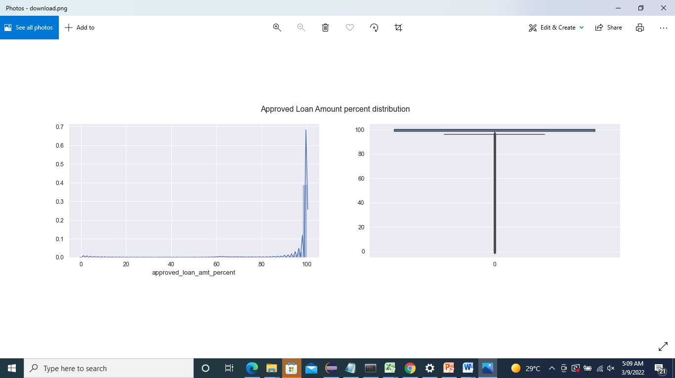
Analyzing Approved Loan Amount percentage
Observations
80% of Borrowers got 100% loan amount from investors.

Slide 4
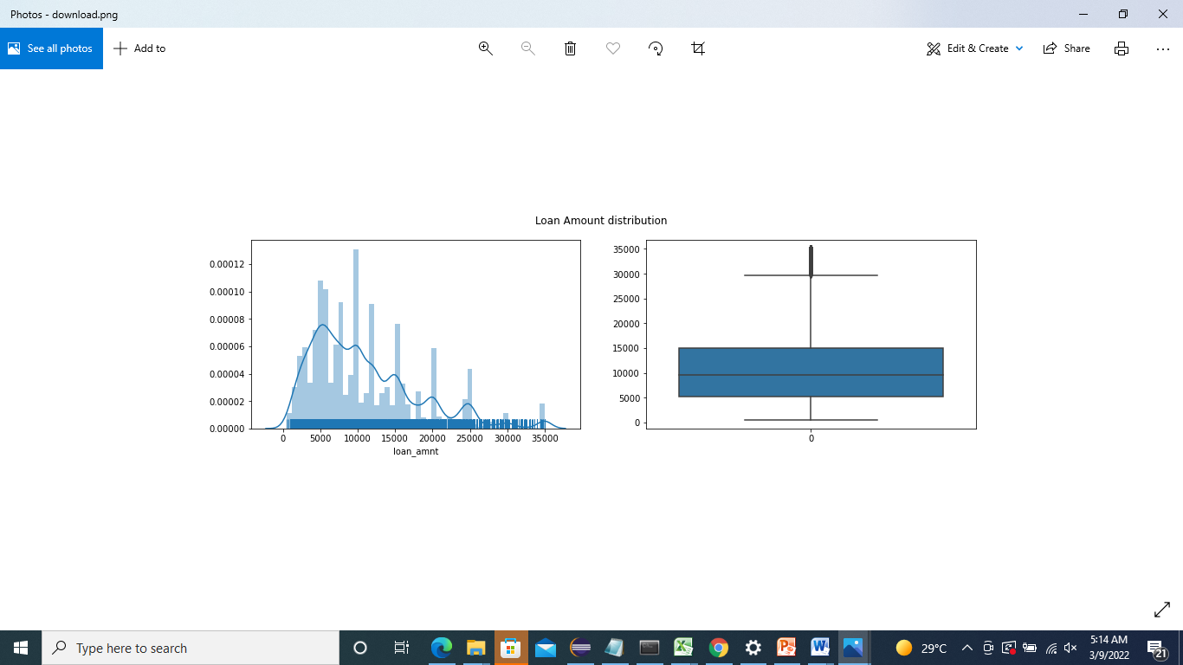
Analyzing Loan amount¶
From loan amount data, we can say that most of them have taken their loan between 5000 and 15000.

Slide 5
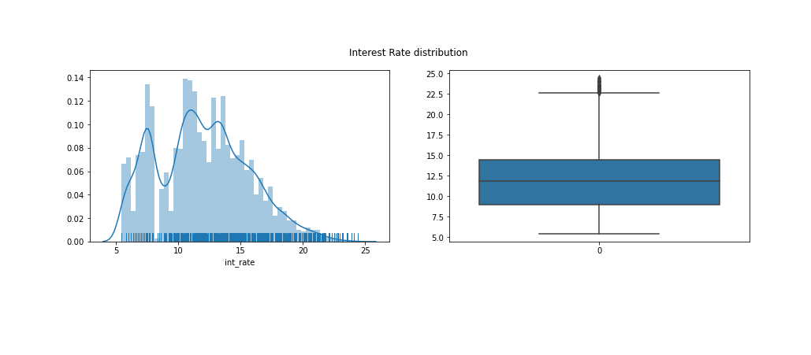
Analyzing Interest Rate
Observations
From interest rate data, we can say that most of the interest rate lies between 9% to 14.5%.

Slide 6
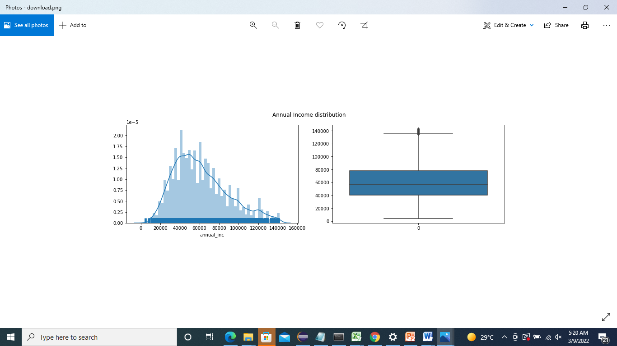
Analyzing Annual Income
Observations
From annual income data, we can say that most of the borrower's annual income are in range of 40k to 80k.

Slide 7
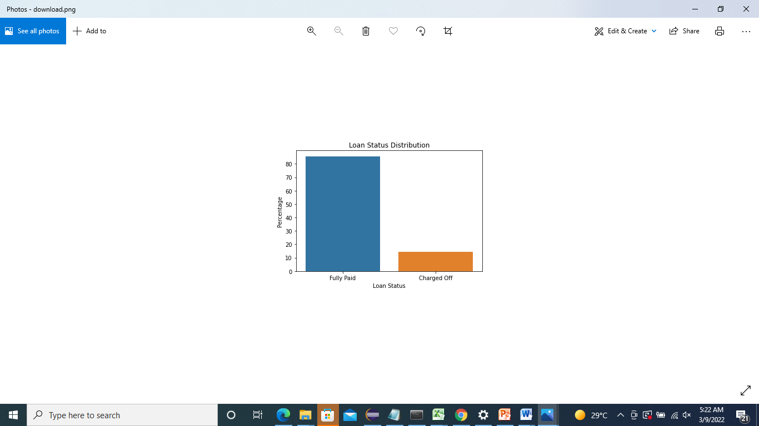
Unordered Categorical Variables
Analyzing Loan Status
Observations
From loan status data, we can say that 85.7% have fully paid whereas 14.3% are charged off.

Slide 8
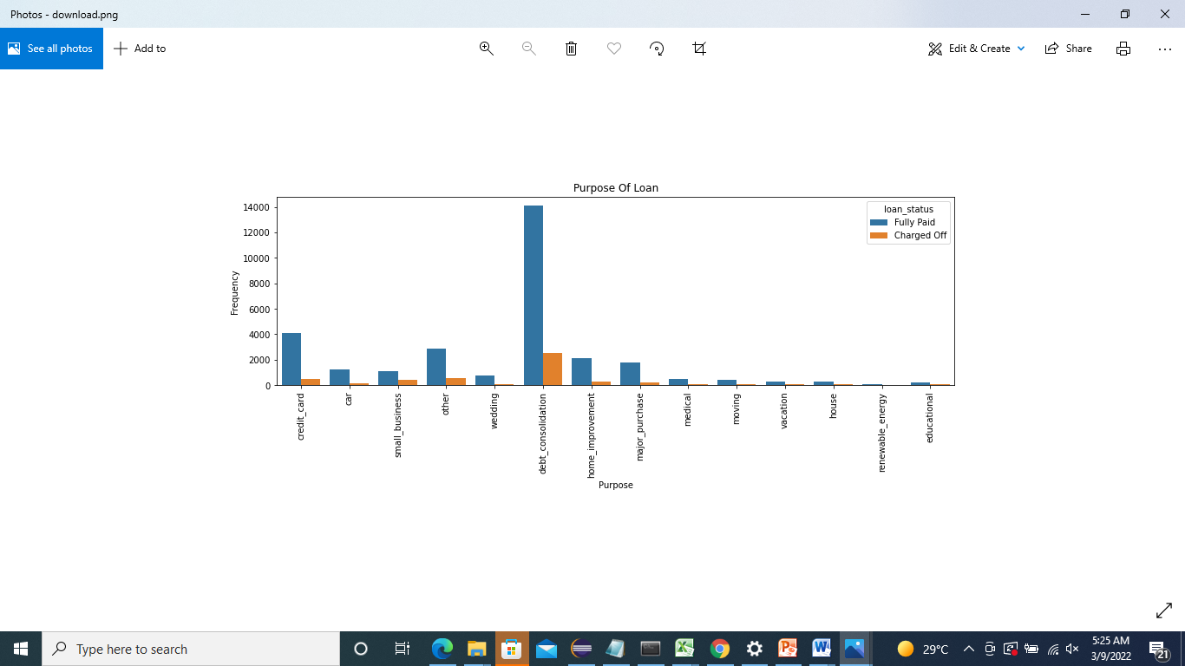
Analyzing Purpose of Loan
Observations¶
From purpose data, we can say that most of them have taken loan for debt consolidation and paying credit card bills.
Charged Off loan status is also high for debt consolidation.

Slide 9
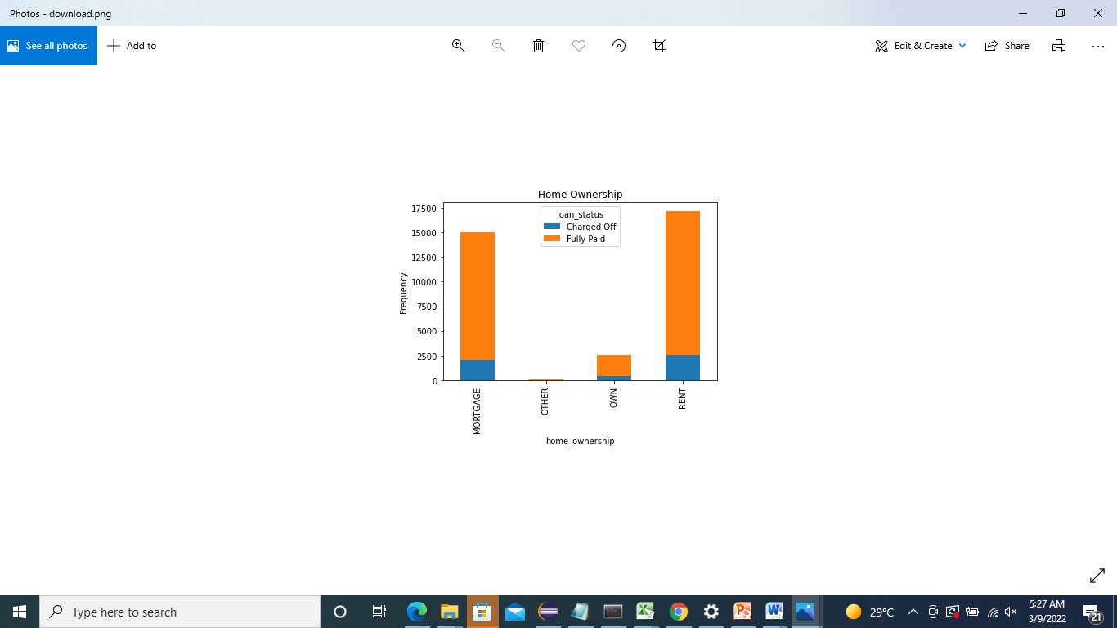
Analyzing Home Ownership
Observations
From home ownership data, we can say that most of them have taken loan who are in rent or mortgage their home.
Charged Off loan status is also high for these two home ownership.

Slide 10
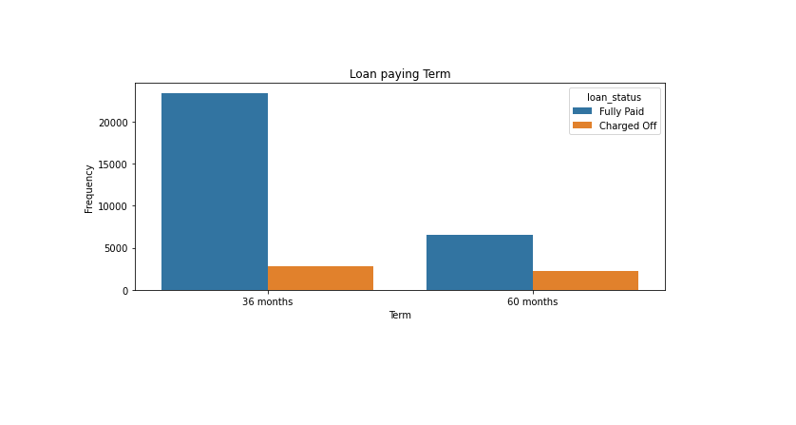
Ordered Categorical Variables
Analyzing Loan paying term
Observations
From term data, we can say that most of them have taken loan for 36 months as compared to 60 months.
Charged Off loan status is also high for 60 months term wrt 36 months.

Slide 11
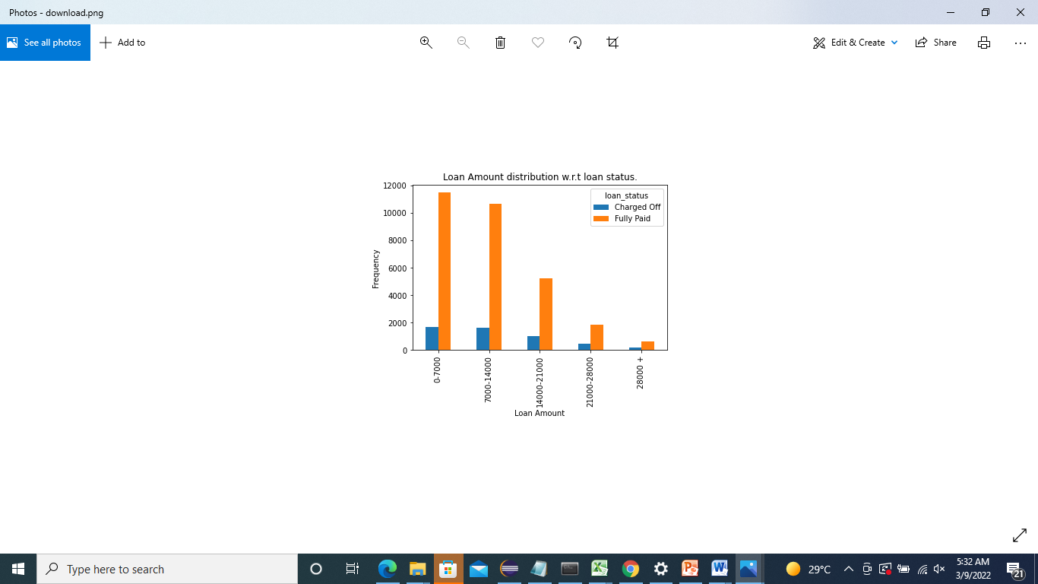
Segmented Univariate Analysis
Observations
From above we can say that, under 14k most of the borrowers take the loan amount and charged off status is also high for those amount.

Slide 12
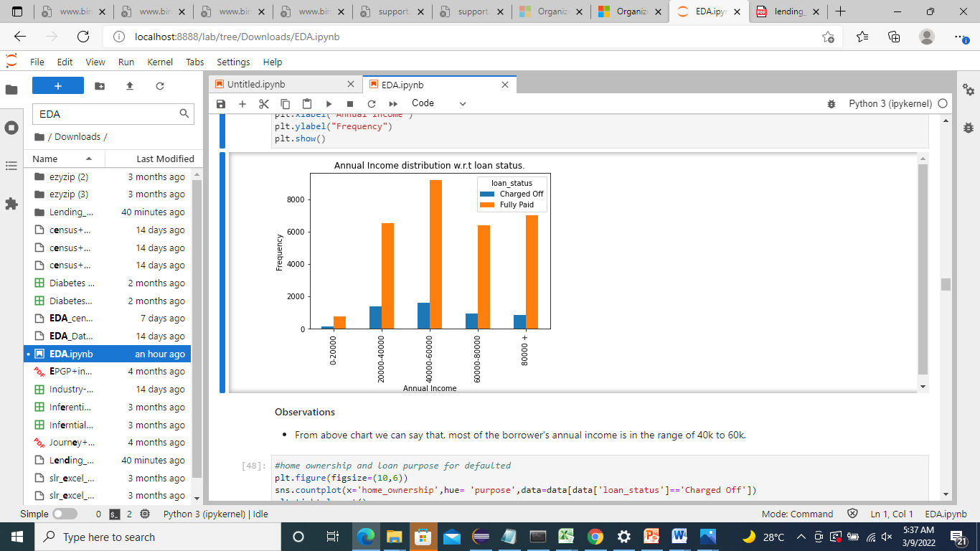
Observations
From above chart we can say that, most of the borrower's annual income is in the range of 40k to 60k.

Slide 13
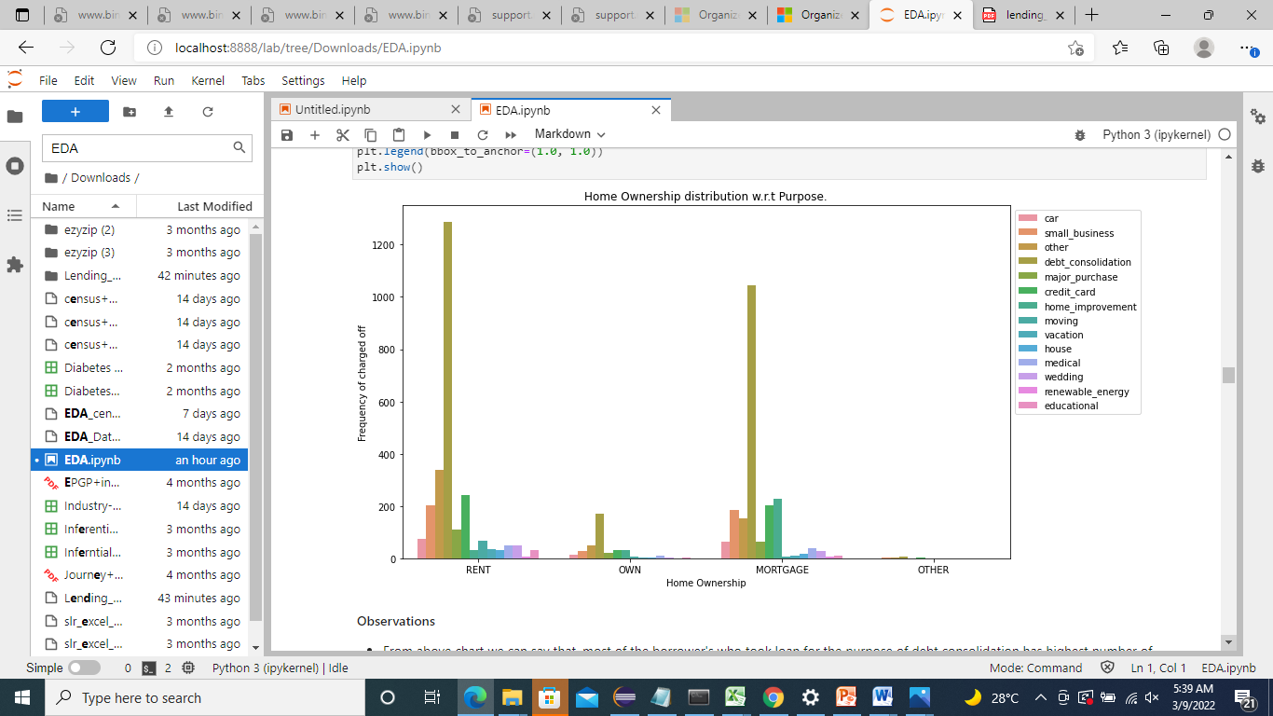
Observations
From above chart we can say that, most of the borrower's who took loan for the purpose of debt consolidation has highest number of Charged off status and those who are in rent as the most.

Slide 14
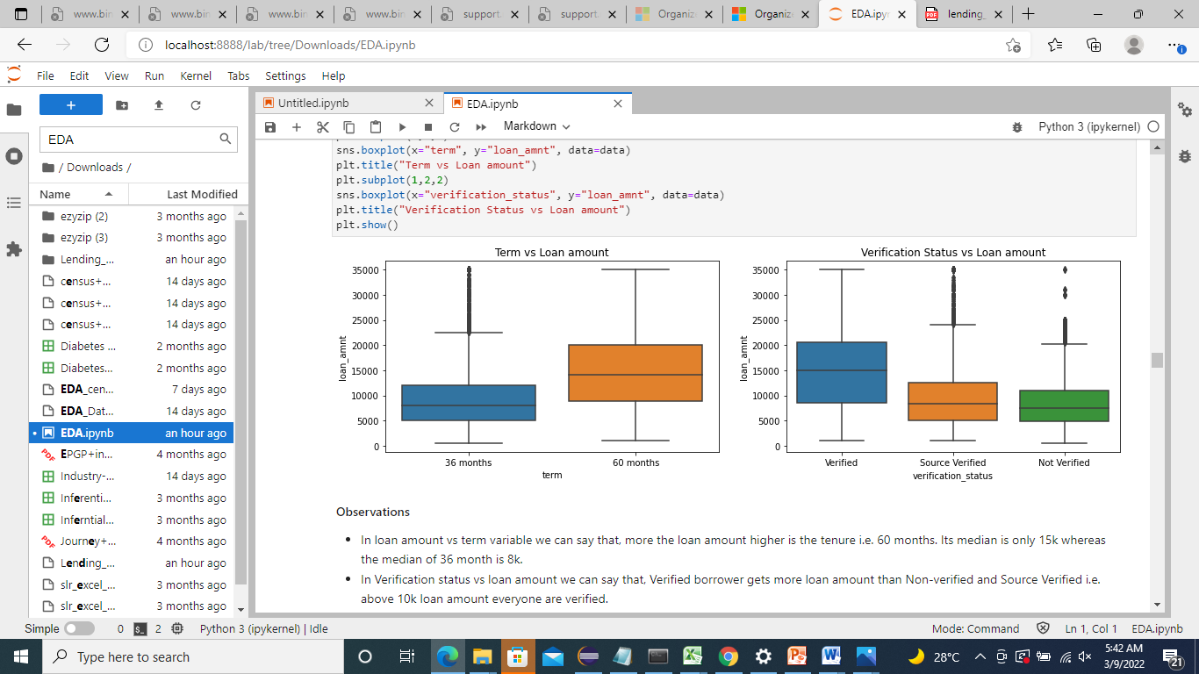
Bivariate Analysis
Analysing loan amount with every variables
Observations
In loan amount vs term variable we can say that, more the loan amount higher is the tenure i.e. 60 months. Its median is only 15k whereas the median of 36 month is 8k.
In Verification status vs loan amount we can say that, Verified borrower gets more loan amount than Non-verified and Source Verified i.e. above 10k loan amount everyone are verified.

Slide 15
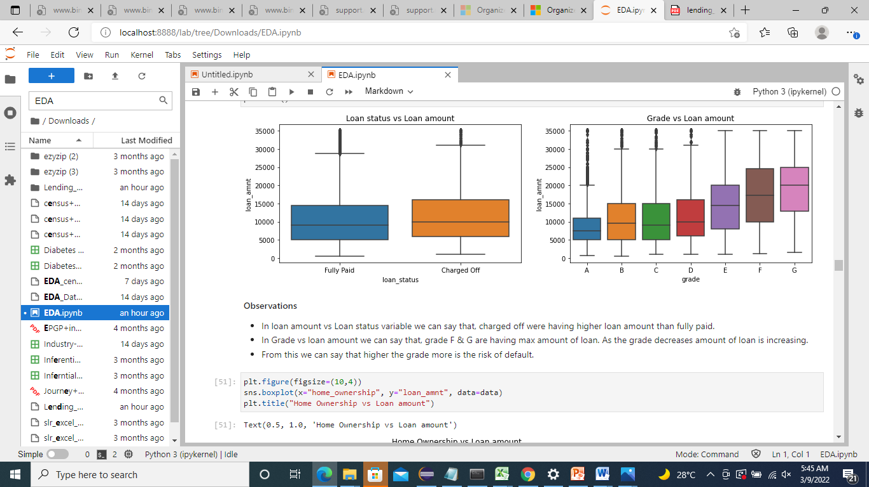
Observations
In loan amount vs Loan status variable we can say that, charged off were having higher loan amount than fully paid.
In Grade vs loan amount we can say that, grade F & G are having max amount of loan. As the grade decreases amount of loan is increasing.
From this we can say that higher the grade more is the risk of default.

Slide 16
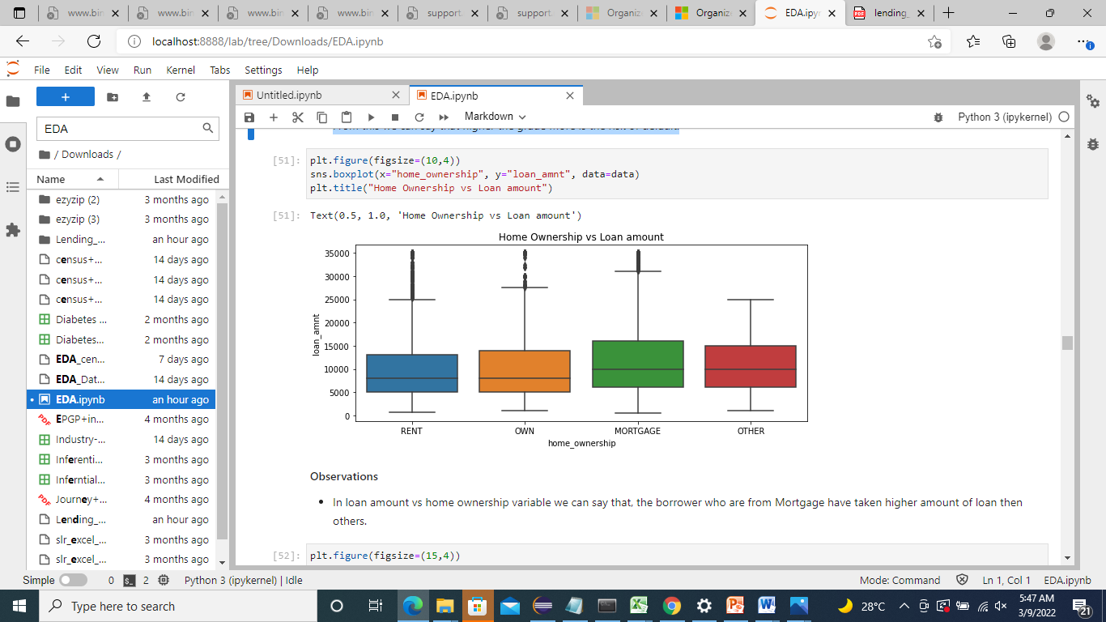
Observations¶
In loan amount vs home ownership variable we can say that, the borrower who are from Mortgage have taken higher amount of loan then others.

Slide 17
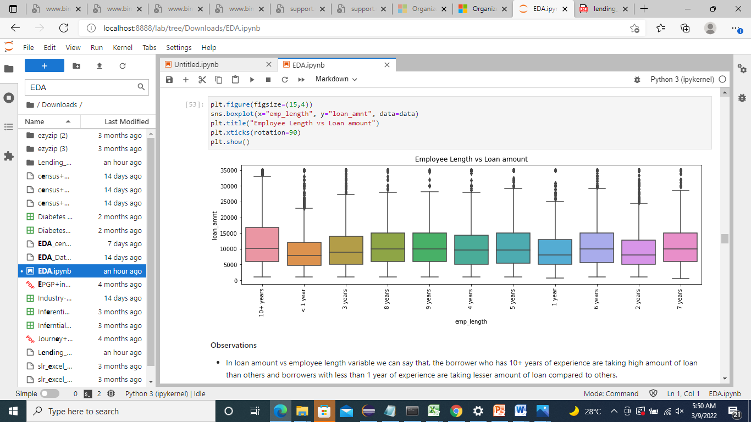
Observations
In loan amount vs employee length variable we can say that, the borrower who has 10+ years of experience are taking high amount of loan than others and borrowers with less than 1 year of experience are taking lesser amount of loan compared to others.

Slide 18
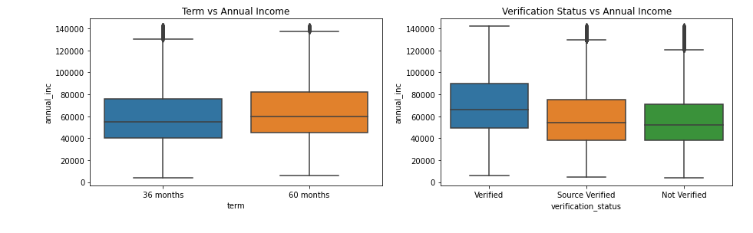
Analysing Annual Income with every variables
Observations
In Term vs Annual Income variable we can say that, the borrowers who have high annual income are taking loans for 60 months tenure as compared to 36 months.
In Verification status vs annual income we can say that, mostly the verified borrowers are having high annual income than others.

Slide 19
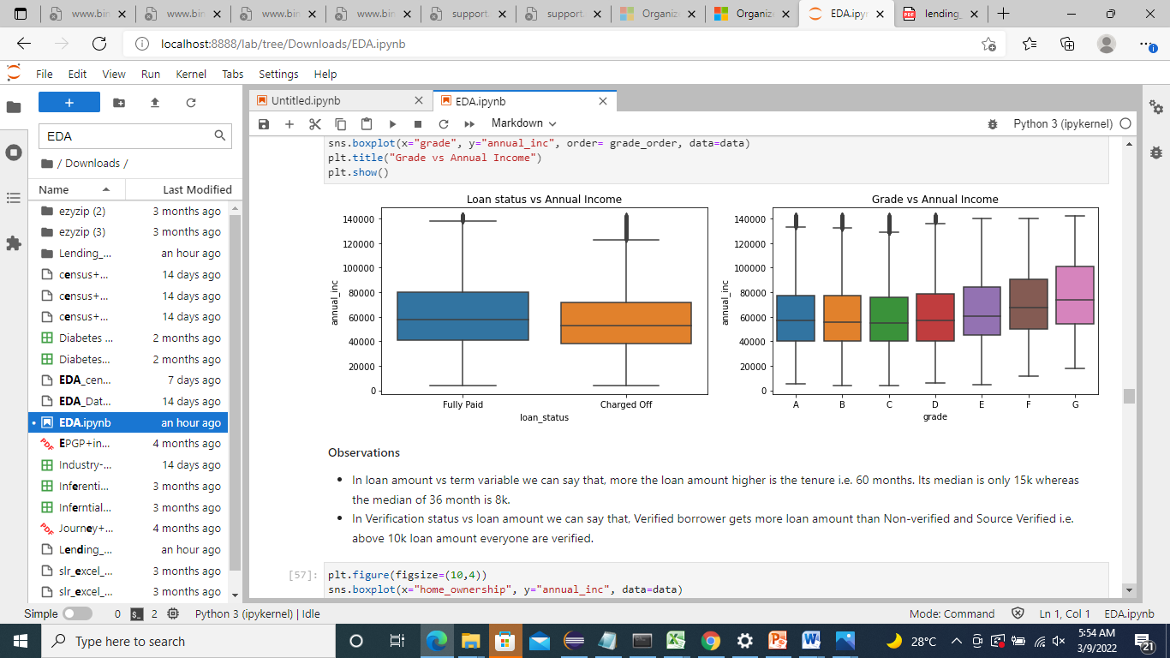
Observations¶
In loan amount vs term variable we can say that, more the loan amount higher is the tenure i.e. 60 months. Its median is only 15k whereas the median of 36 month is 8k.
In Verification status vs loan amount we can say that, Verified borrower gets more loan amount than Non-verified and Source Verified i.e. above 10k loan amount everyone are verified.

Slide 20
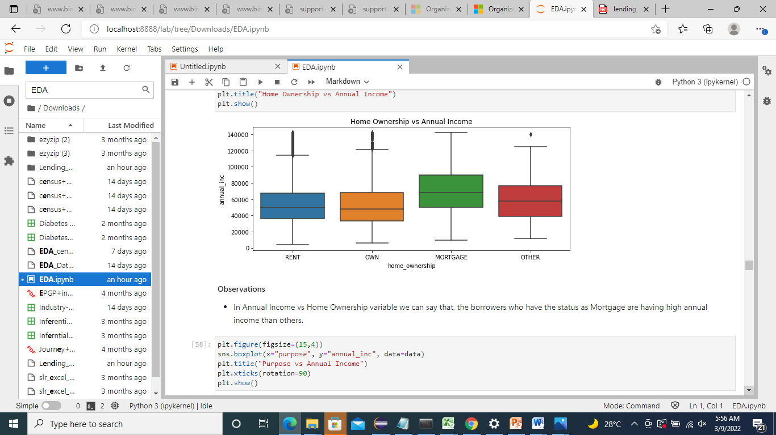
Observations¶
In Annual Income vs Home Ownership variable we can say that, the borrowers who have the status as Mortgage are having high annual income than others.
Observations¶
In Annual Income vs Home Ownership variable we can say that, the borrowers who have the status as Mortgage are having high annual income than others.

Slide 21
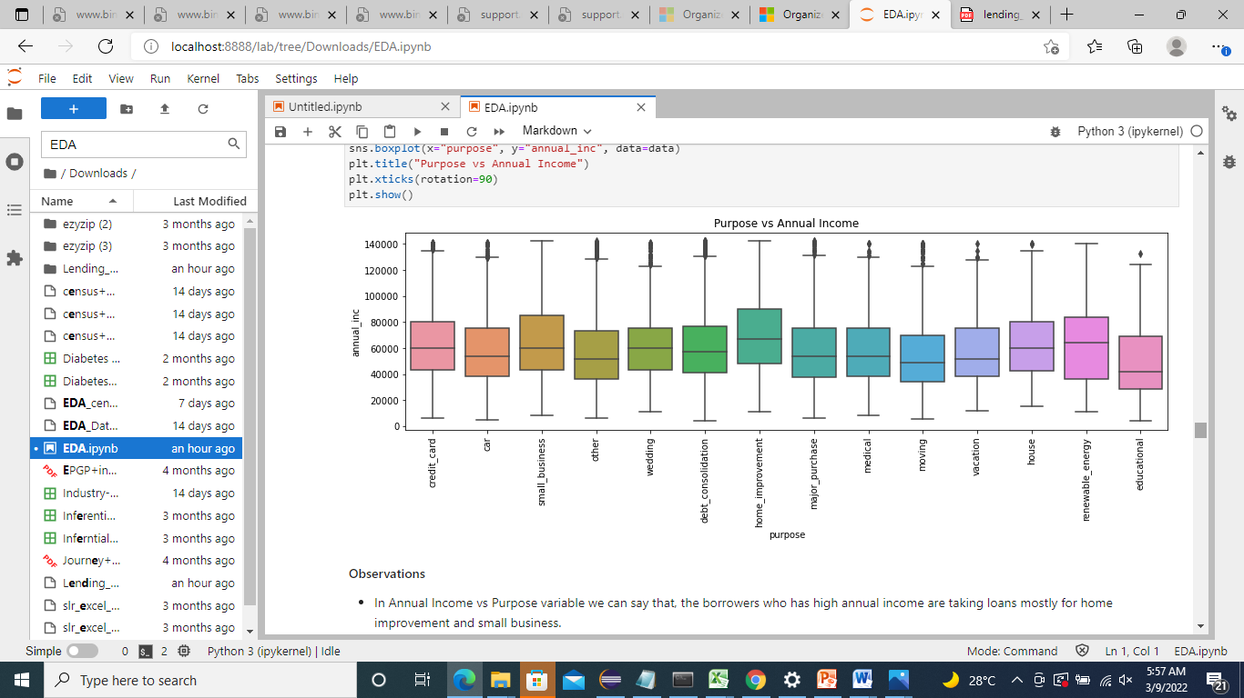
Observations
In Annual Income vs Purpose variable we can say that, the borrowers who has high annual income are taking loans mostly for home improvement and small business.
Observations
In Annual Income vs Purpose variable we can say that, the borrowers who has high annual income are taking loans mostly for home improvement and small business.

Slide 22
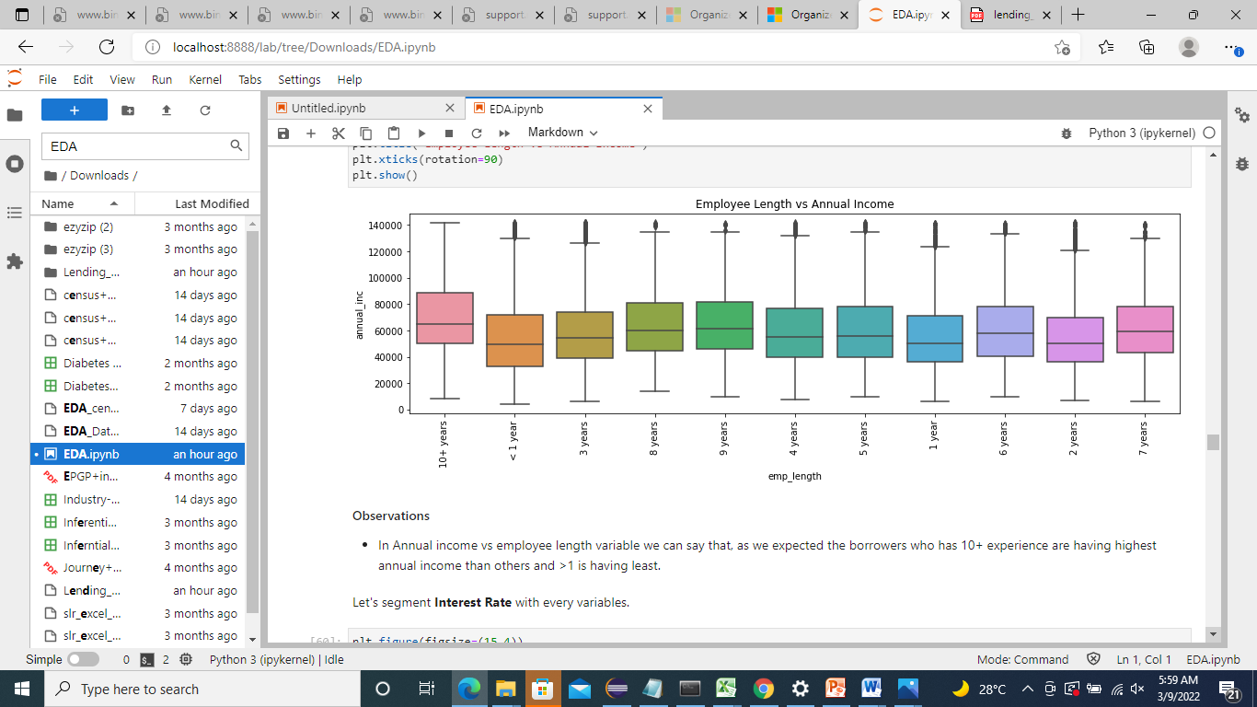
Observations
In Annual income vs employee length variable we can say that, as we expected the borrowers who has 10+ experience are having highest annual income than others and >1 is having least.

Slide 23
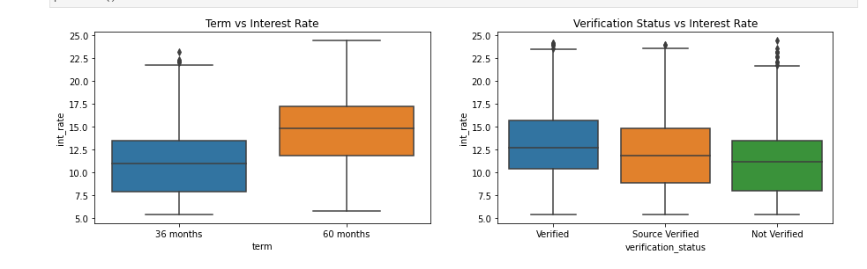
Analysing Interest Rate with every variables
Observations
In term vs interest rate variable we can say that, interest rate is less for those who take loan for 36 months and high for 60 months.
In term vs interest rate variable we can say that, Verified borrower gets more loan at higher interest rate compared to others.

Slide 24
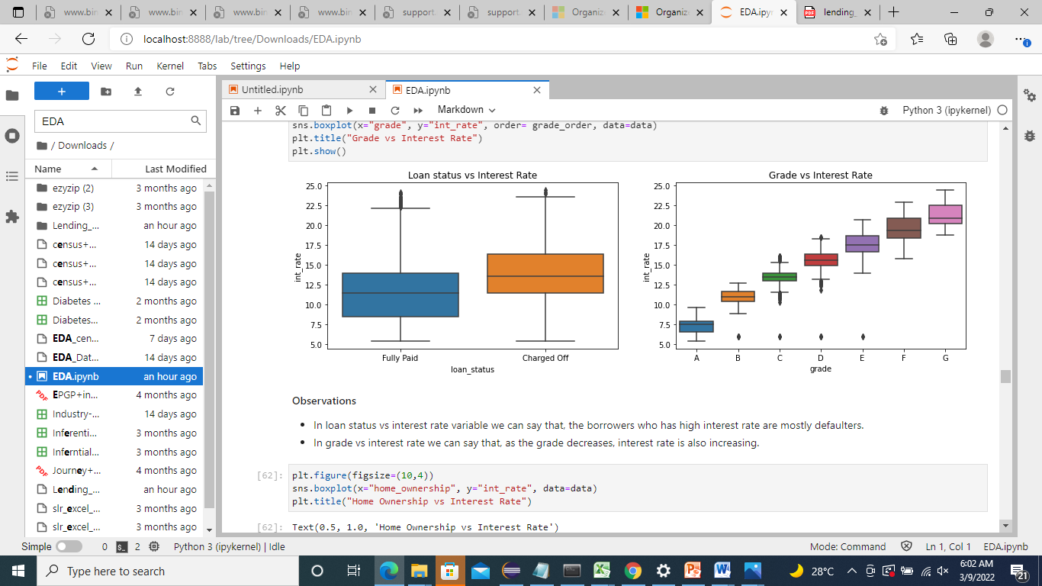
Observations
In loan status vs interest rate variable we can say that, the borrowers who has high interest rate are mostly defaulters.
In grade vs interest rate we can say that, as the grade decreases, interest rate is also increasing.

Slide 25
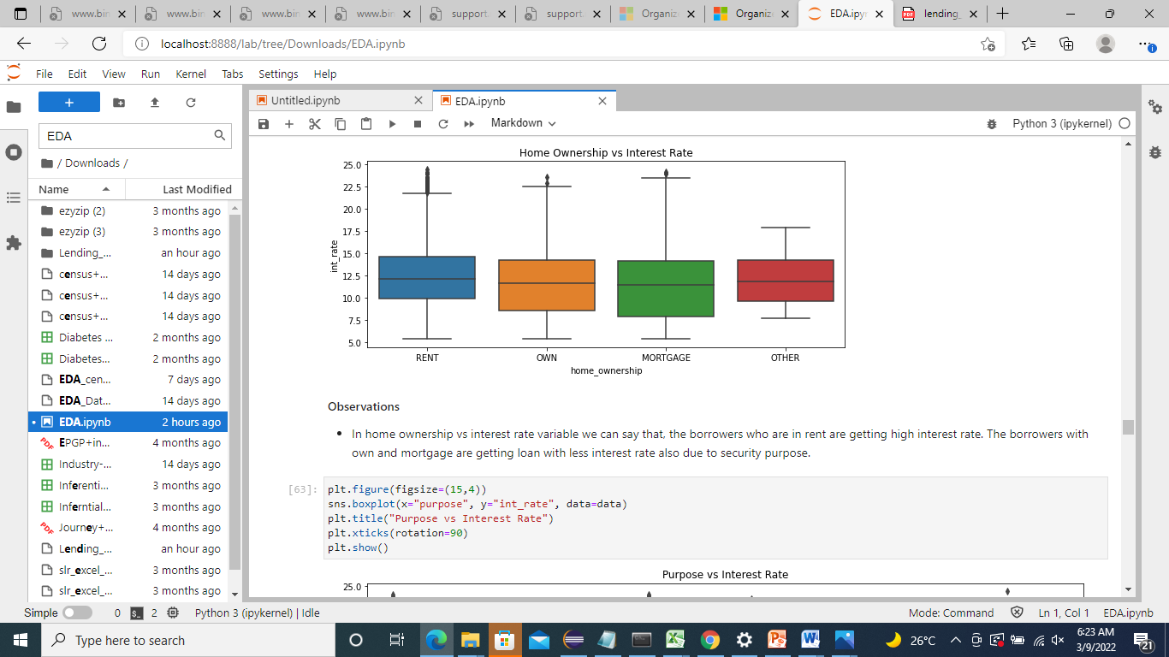
Observations
In home ownership vs interest rate variable we can say that, the borrowers who are in rent are getting high interest rate. The borrowers with own and mortgage are getting loan with less interest rate also due to security purpose.

Slide 26
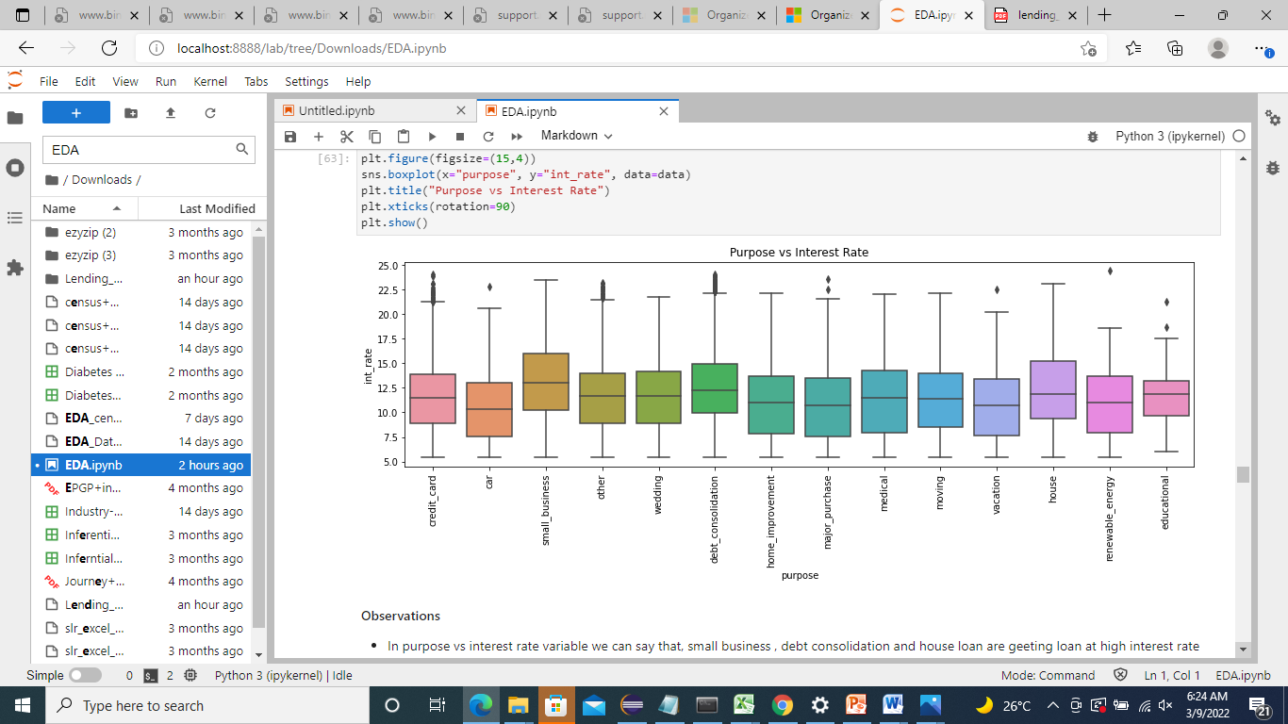
Observations
In purpose vs interest rate variable we can say that, small business , debt consolidation and house loan are geeting loan at high interest rate than others.

Slide 27
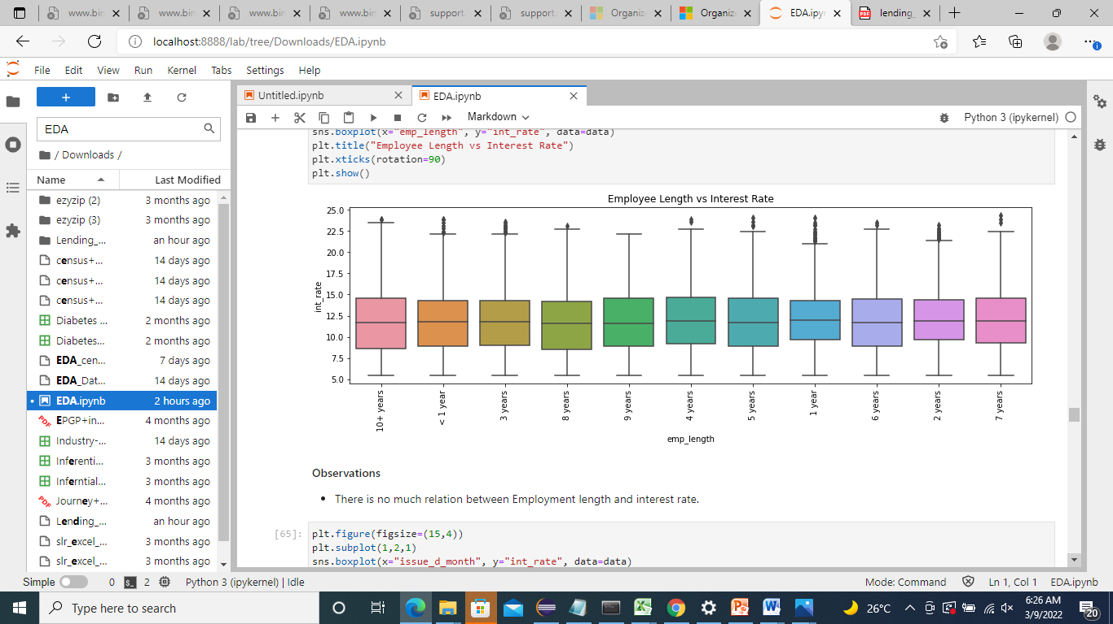
Observations
There is no much relation between Employment length and interest rate.

Slide 28
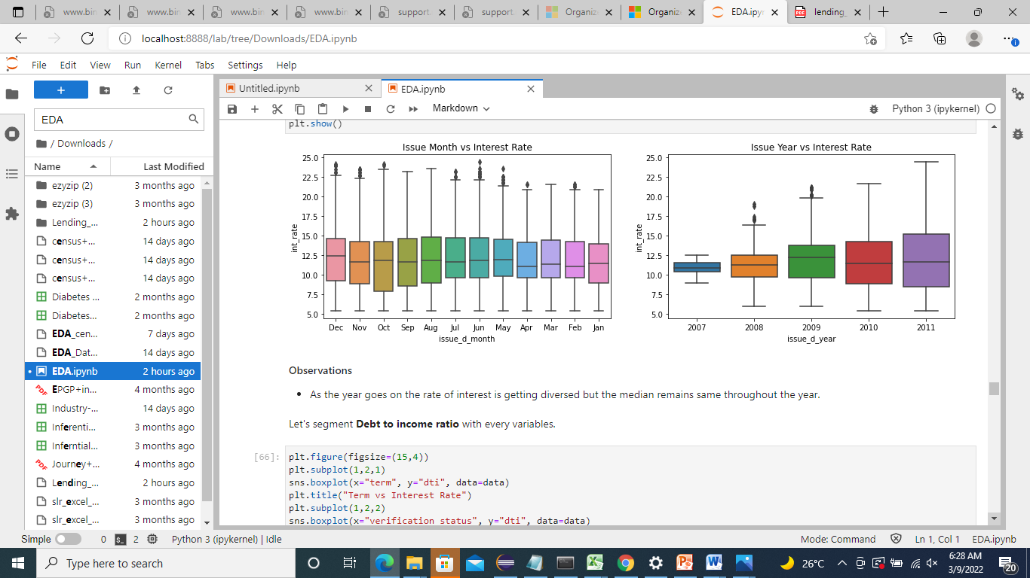
Observations
As the year goes on the rate of interest is getting diversed but the median remains same throughout the year

Slide 29
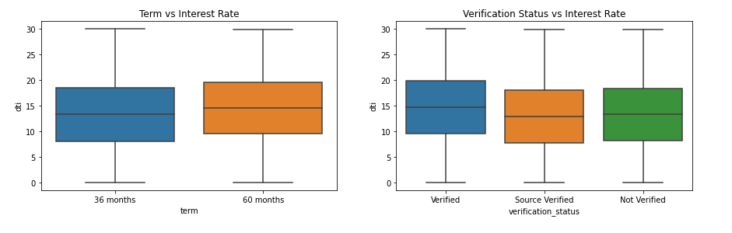
Analysing Debt to income ratio with every variables
Observations
In interest rate vs term variable we can say that, dti ratio is high for the borrower who has 60 months tenure.
In Verification status vs dti we can say that, verified borrowers are having high dti ratio.

Slide 30
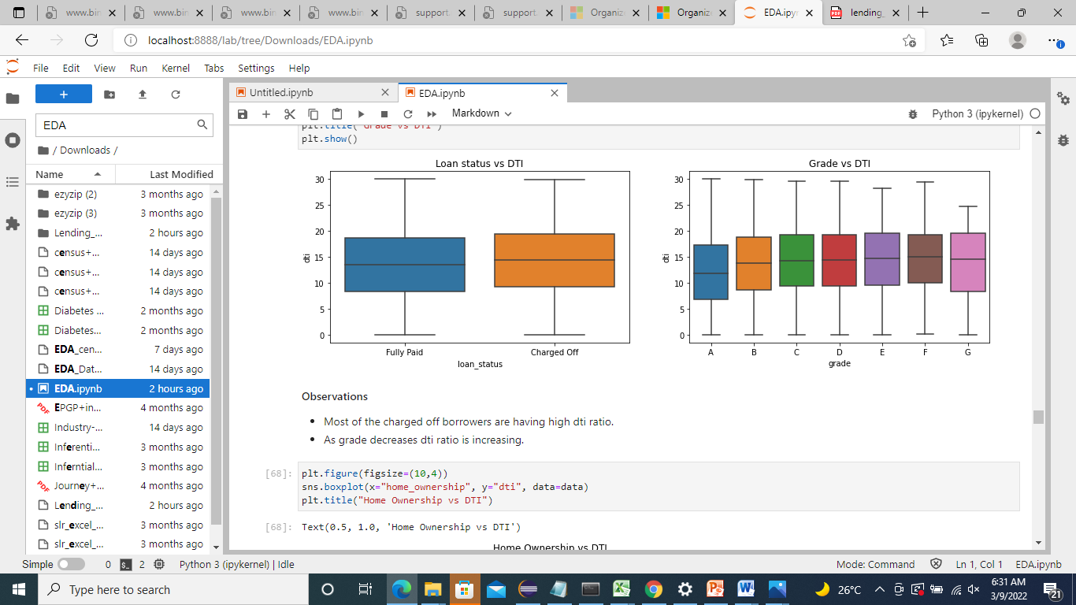
Observations
Most of the charged off borrowers are having high dti ratio.
As grade decreases dti ratio is increasing.

Slide 31
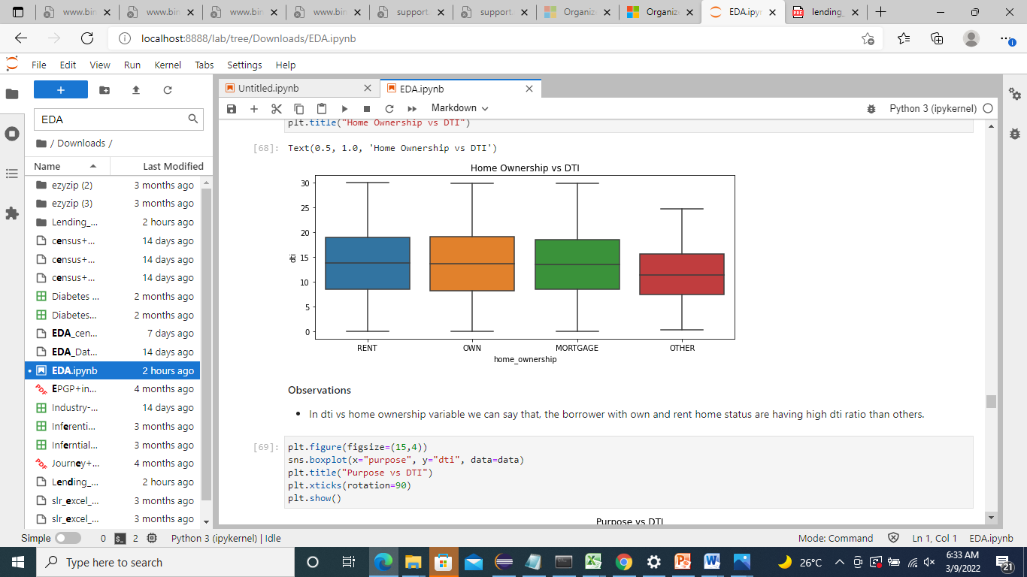
Observations
In dti vs home ownership variable we can say that, the borrower with own and rent home status are having high dti ratio than others.

Slide 32
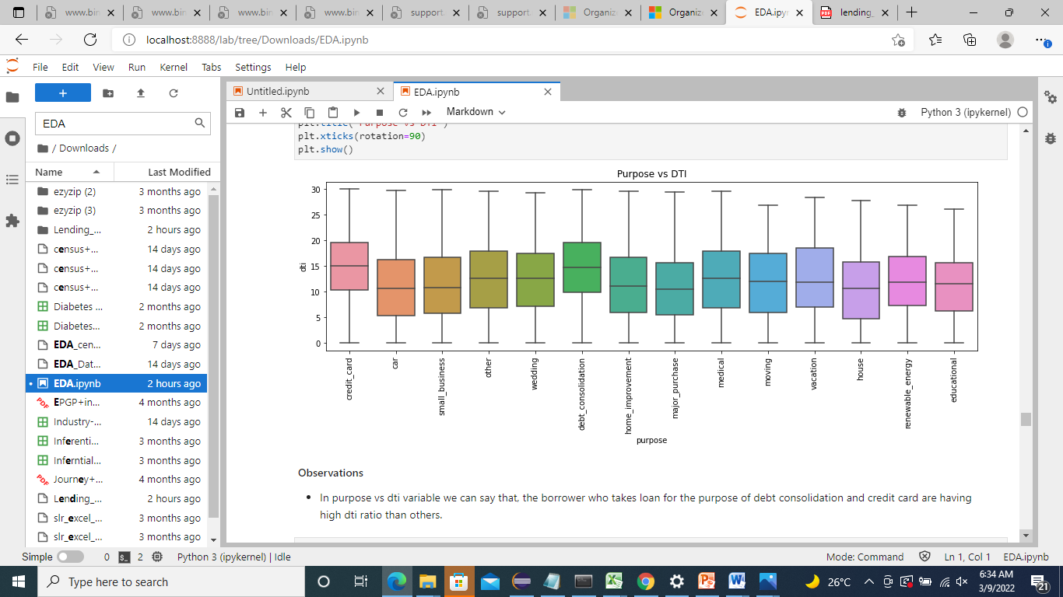
Observations
In purpose vs dti variable we can say that, the borrower who takes loan for the purpose of debt consolidation and credit card are having high dti ratio than others.

Slide 33
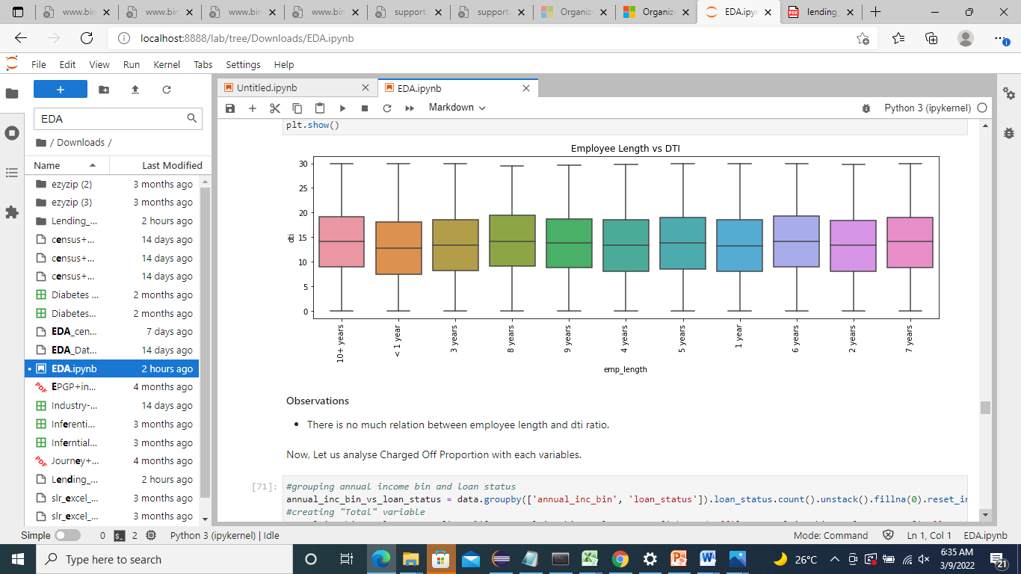
Observations¶
There is no much relation between employee length and dti ratio.

Slide 34
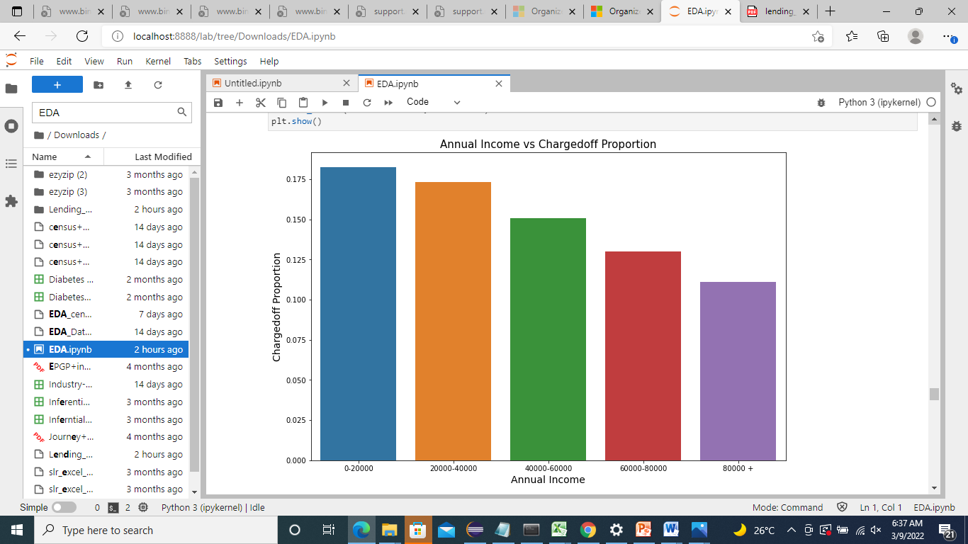
Analysing Charged Off Proportion with each variables.
Observations¶
From above chart we can say that, as annual income is increasing charged off proportion is decreasing.
So highest charged off proportion are in the range 0 to 20k annual income.

Slide 35
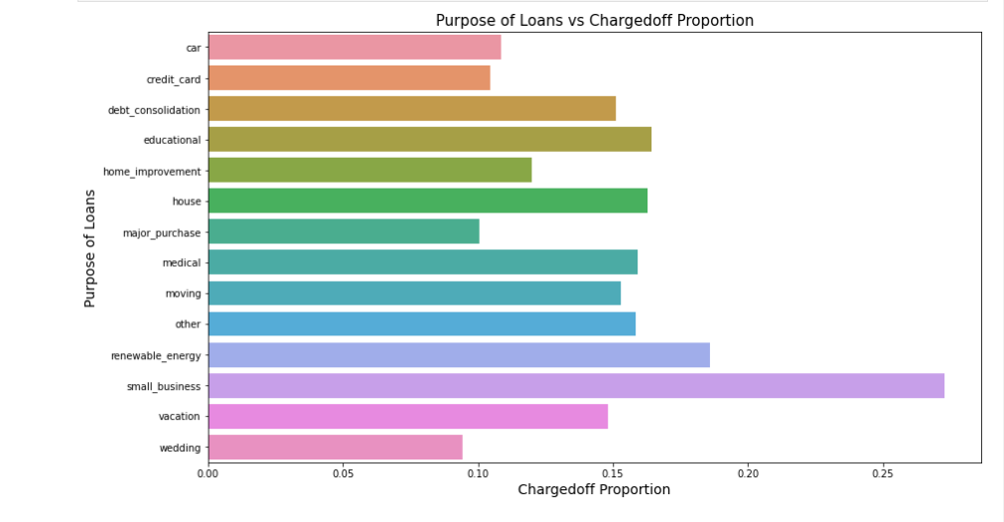
Observations
From above we can say that, the borrower who take loan for the purpose of small-business has the maximum charged off proportion.

Slide 36
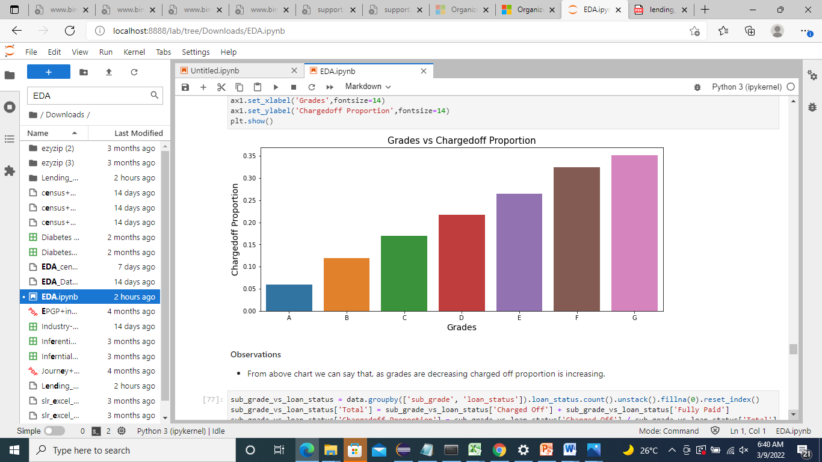
Observations
From above chart we can say that, as grades are decreasing charged off proportion is increasing.

Slide 37
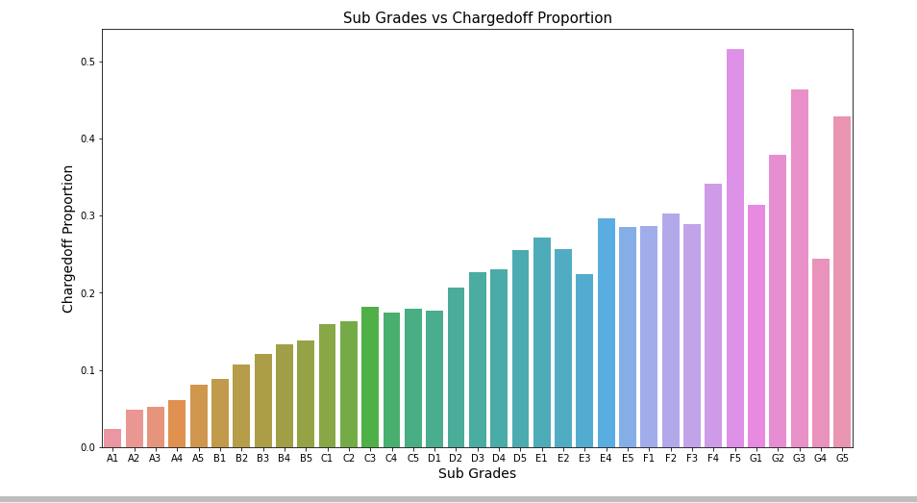
Observations¶
Subgrade F5, G3 and G5 are having maximum charged off proportion.

Slide 38
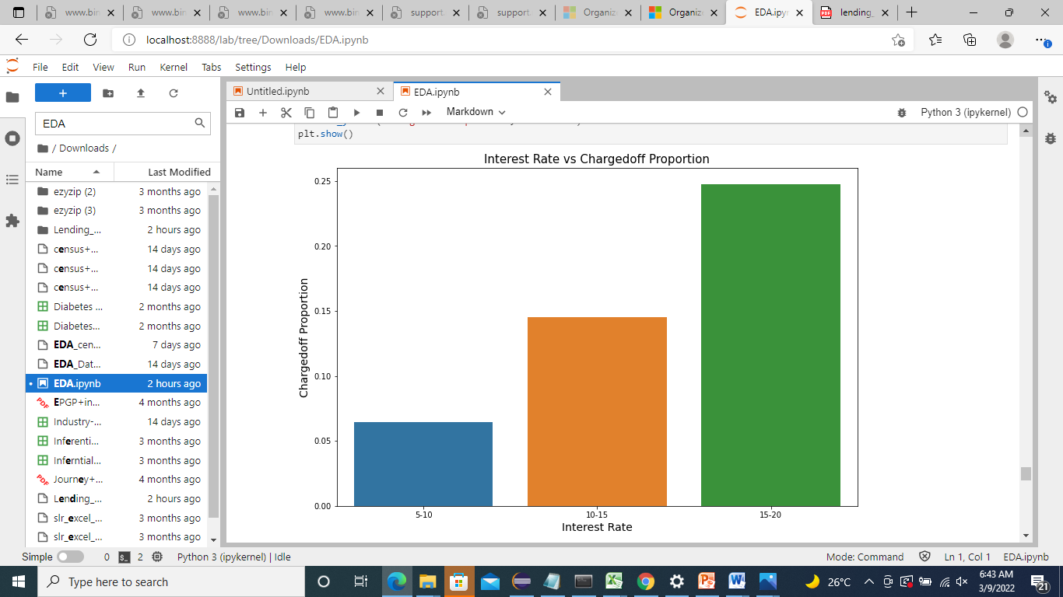
Observations
As interest rate are increasing, charged off proportion is also increasing.
The borrower who takes loan at the interest rate of 15 to 20 are getting mostly charged off.

Slide 39
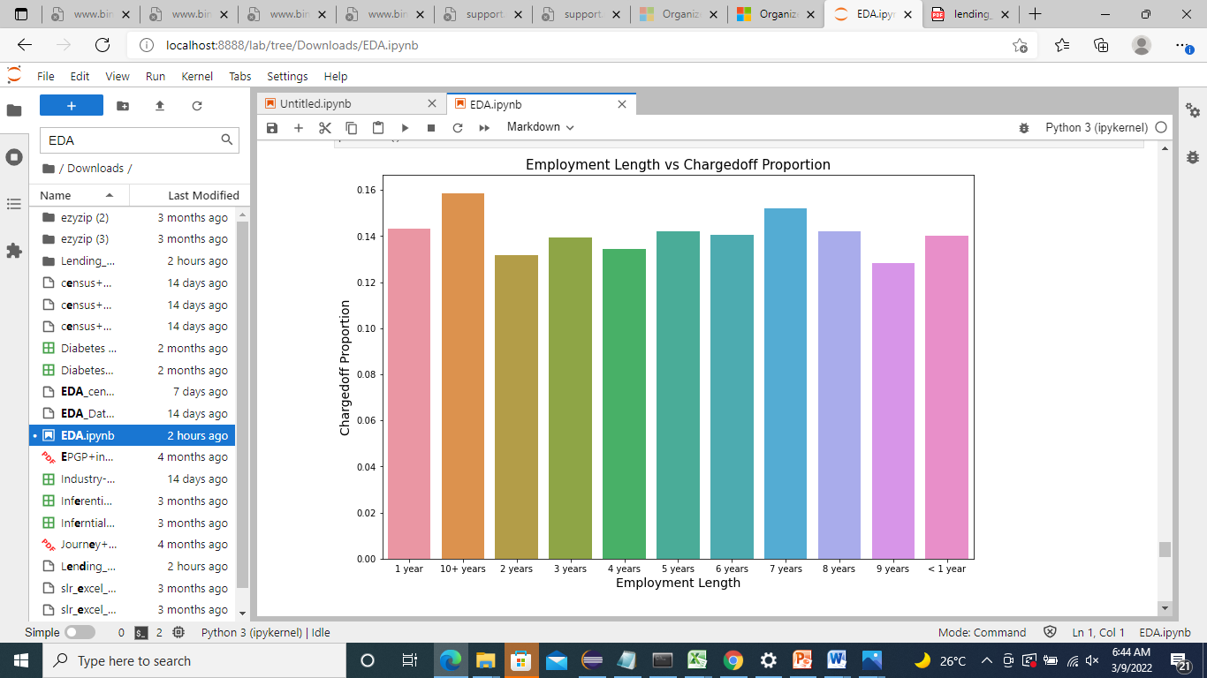
Observations
The borrowers whose employee length is less than 1 year, 1 year and 10+ year are mostly getting charged off.

Slide 40
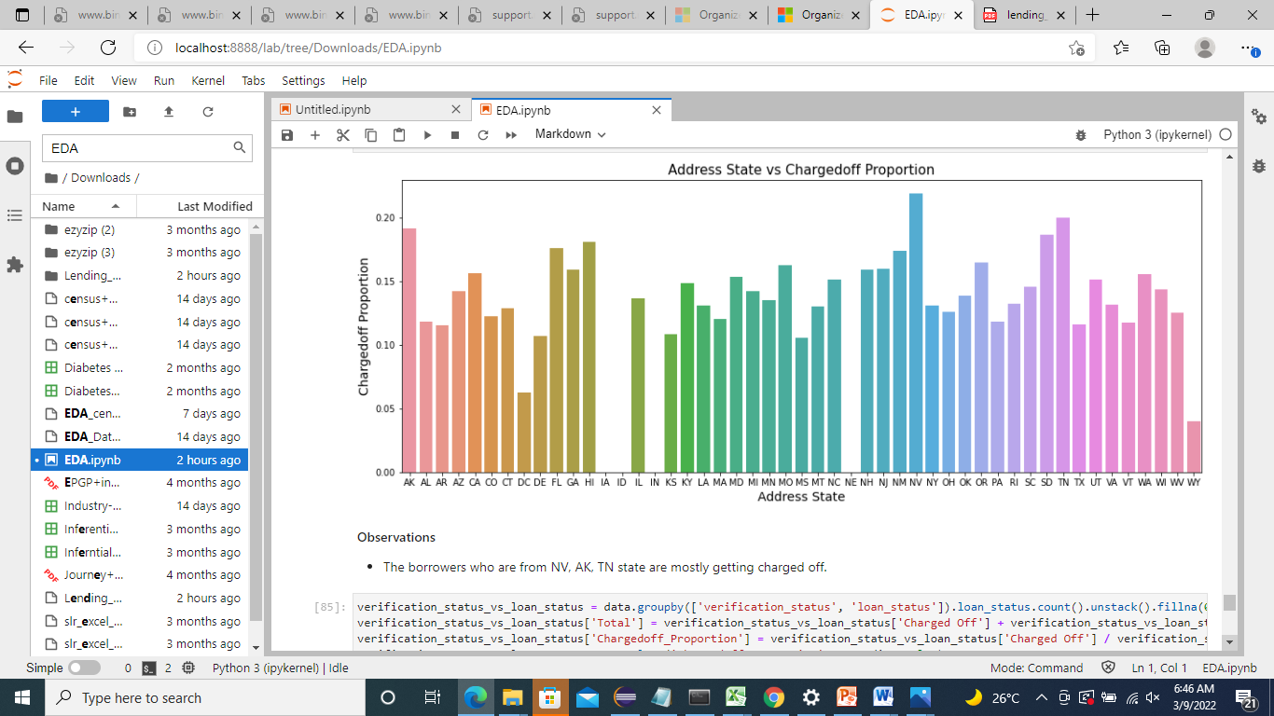
Observations
The borrowers who are from NV, AK, TN state are mostly getting charged off.

Slide 41
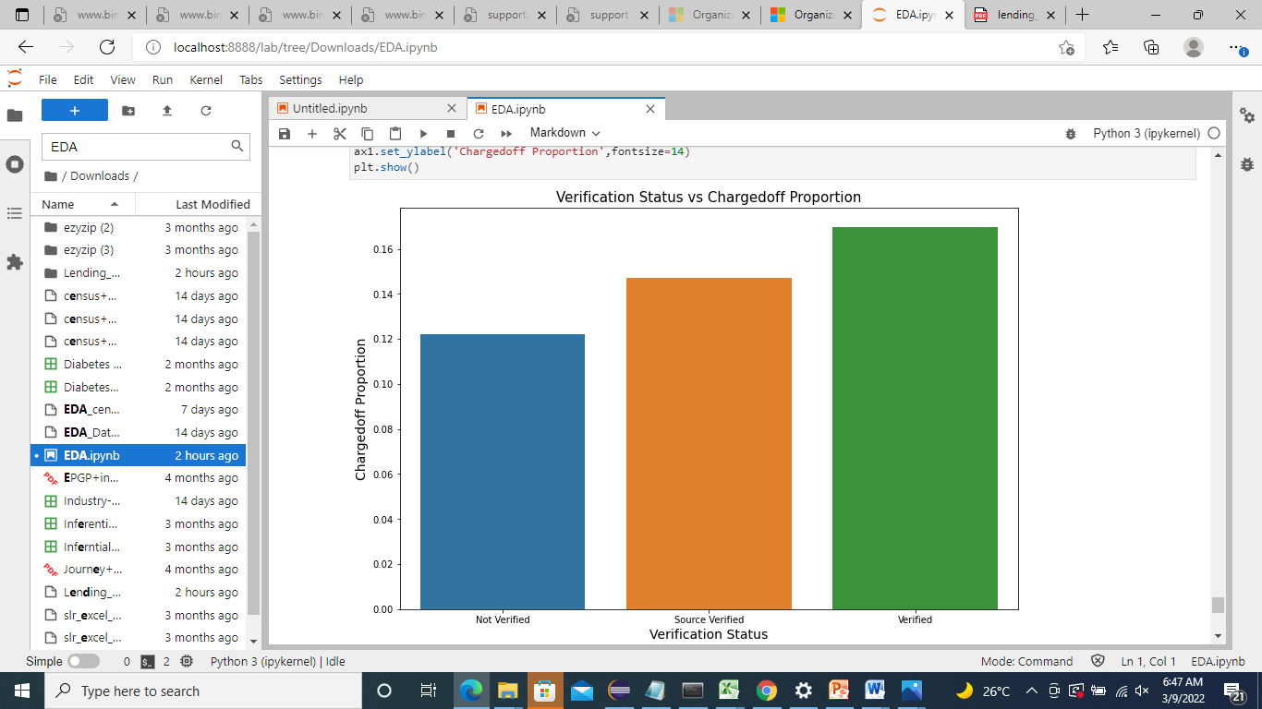
Observations
Most of the verified borrowers are getting charged off then others.

Slide 42
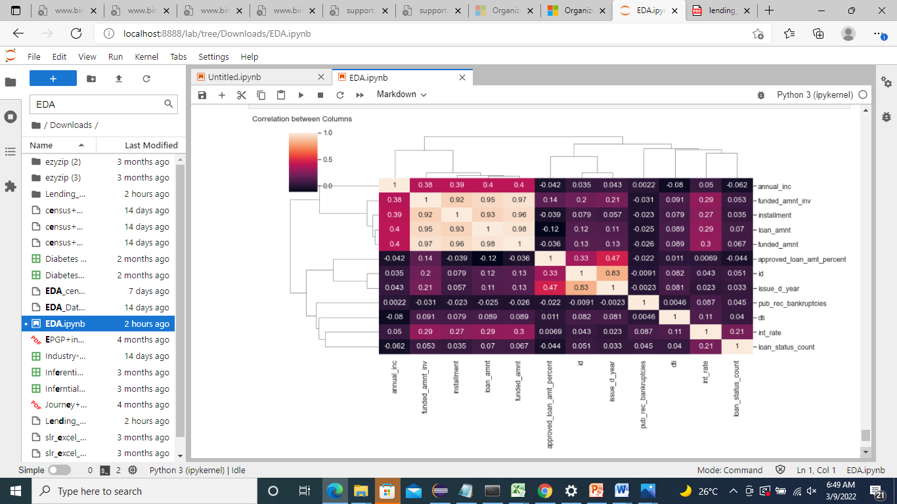
Multivariate Analysis
Observations¶
loan_amnt , funded_amnt , funded_amnt_inv , installment are strongly correlated.
annual_inc and dti is negatively correlated.
Debt income ratio is the percentage of a borrower's monthly gross income that goes toward paying debts.
Which means when annual_inc is low, debt is high and vice versa.

Slide 43
Recommendation
After analysing purpose of loan data we can conclude that loans taken for medical vacation , house , education are fully paid but charge off loan is high for debt consolidation.
After analysing home ownership most have taken loan who are in rent or mortgage their home. Loan defaulter probability for people living in rented house is high. n loan amount vs purpose variable we can say that, to startup with small business borrowers are taking high loan than others. Then comes debt_consolidation.
From data we can analyse that loan is taken mostly for 36 months as compared to 60 months. Charged Off loan status is also high for 60 months term wrt 36 months.
From above we can say that, under 14k most of the borrowers take the loan amount and charged off status is also high for those amount.

Slide 44
From above chart we can say that, most of the borrower's who took loan for the purpose of debt consolidation has highest number of Charged off status and those who are in rent as the most.
In loan amount vs Loan status variable we can say that, charged off were having higher loan amount than fully paid.
Loan taken for small buissness have higher Charged Off loan status .
In purpose vs dti variable we can say that, the borrower who takes loan for the purpose of debt consolidation and credit card are having high dti ratio than others. And higher the dti ratio shows then Charged off status is also high.
Data shows when employee income increases charged off status deacreases.
The borrowers who are from NV, AK, TN state are mostly getting charged off.
Most of the verified borrowers are getting charged off then others.

Slide 45
Conclusion
Annual Income and Verification process is the main deriving factors behind loan default.
Providing loan for small businesses or people who lives in rented house also shows strong indicators of default.

